Slide 1

Chapel Hill Crime Data Analysis
Austin Odell, Eliot McGinis, Michael Tobin, and Himol Shah
Carolina Data Challenge 2019

Slide 2
The Data
Dataset was gathered from Chapel Hill Open Data
We focused on the police reports written data
Tracks all incident reports filed by the police department from January 1, 2010 to June 29, 2019
Included for each entry is the location and classification of the offense

Slide 3

Goals
Visualize the data to garner insights into crime hotspots
Analyze annual changes in the data over the past decade
Filter data to look for trends in age of victims
Specifically assess crimes against college-aged people

Slide 4
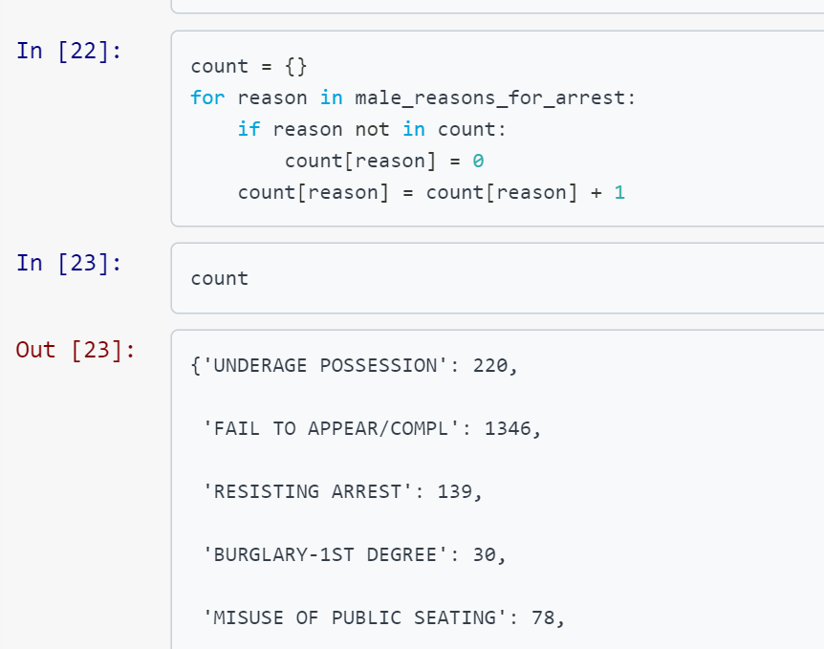
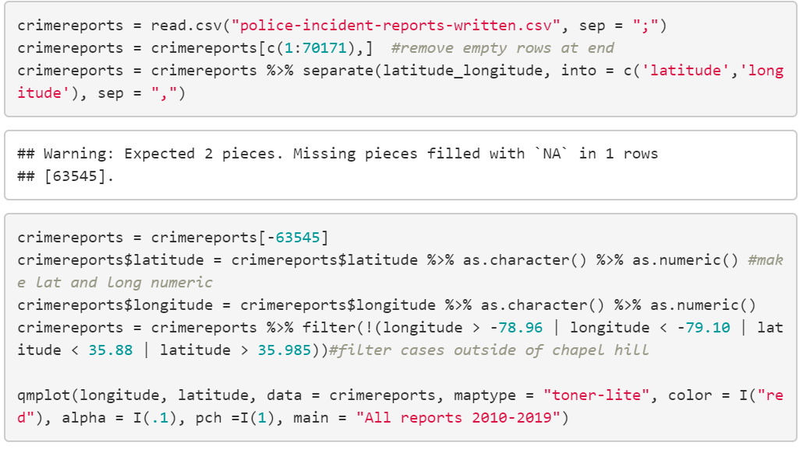
Some of Our Code

Slide 5
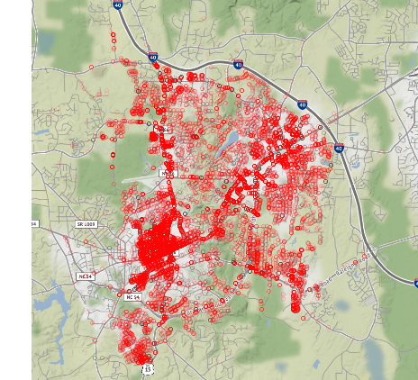
All Crime Mapped

Slide 6
Filtering by Age Range of Victim

Slide 7
Filtering by Year of Crime

Slide 8
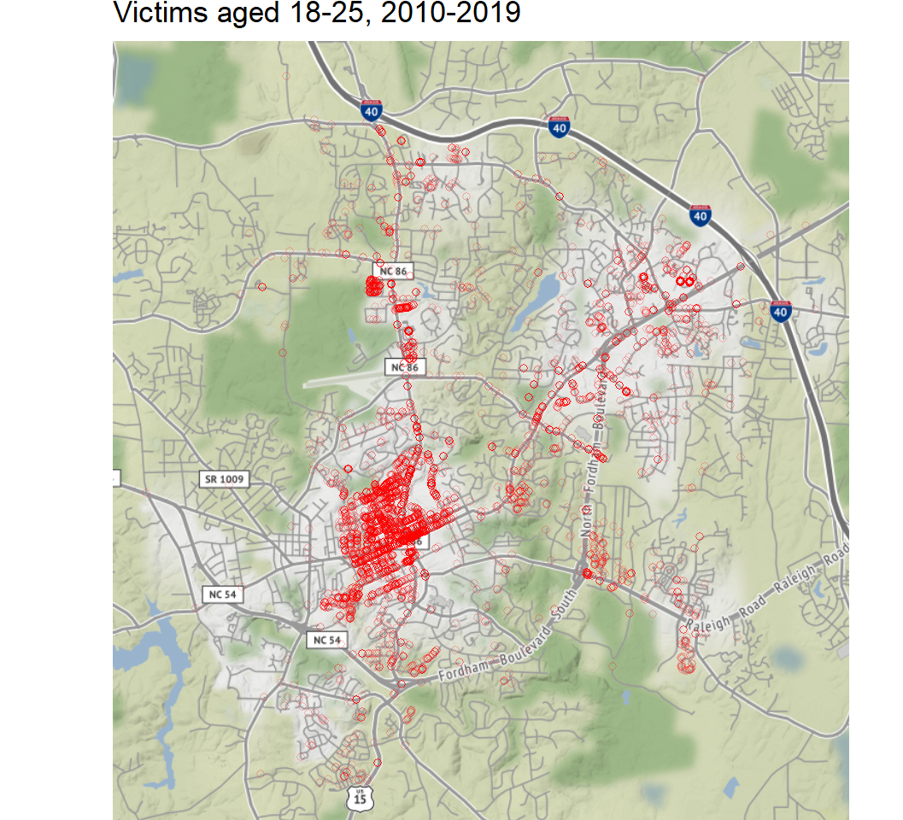
College-Aged Victims
Most of the crimes against college students occur near Franklin street and the downtown area. This is clustered near the edge of campus and where many students live

Slide 9
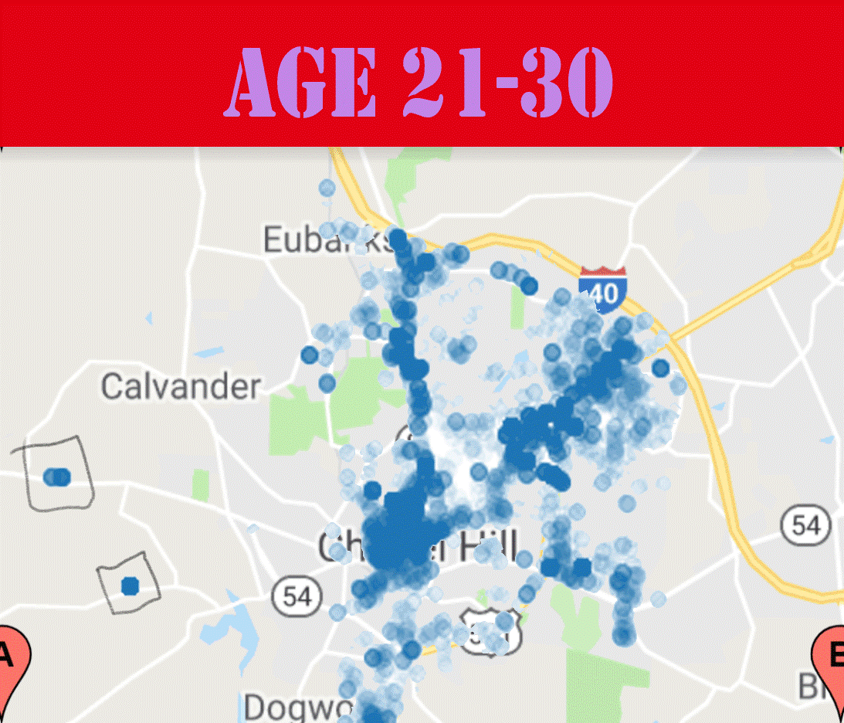
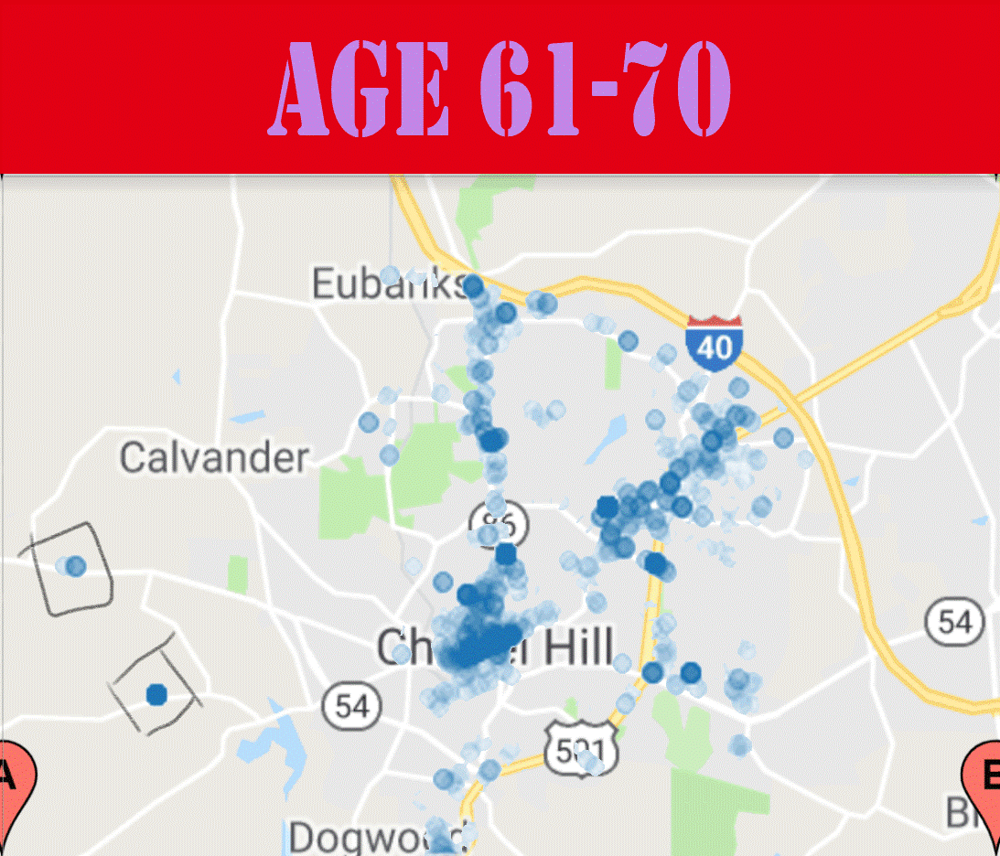
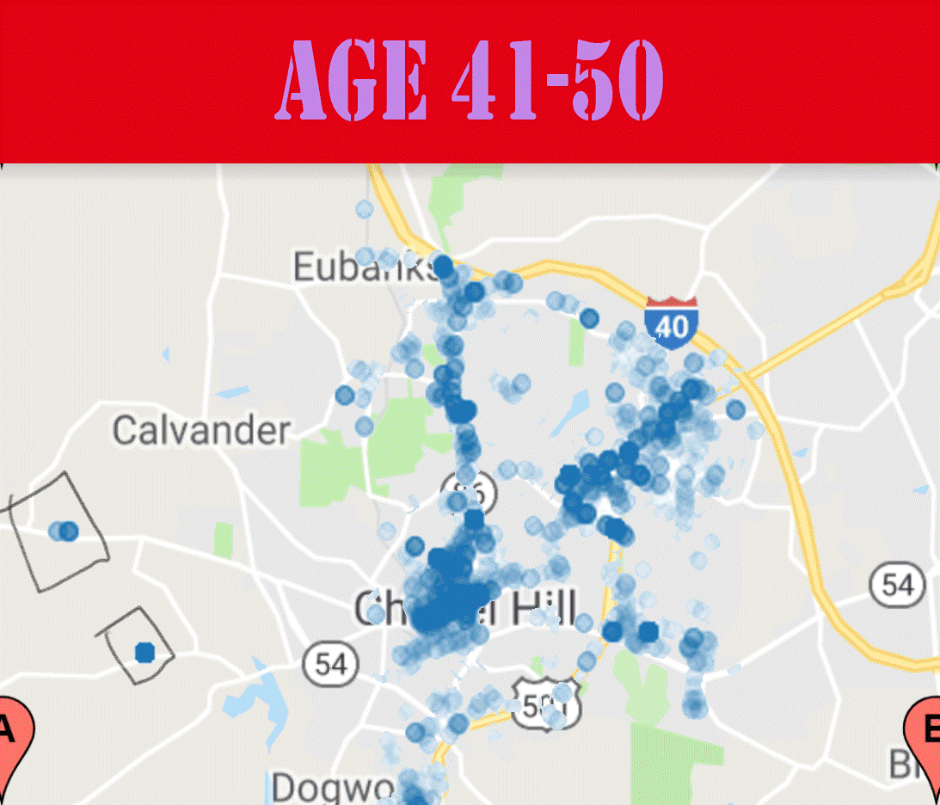
Outlier Observation
Across all ages there are these outlier data points where there are a lot of crimes committed at an area pretty far away from the rest of the crimes.

Slide 10
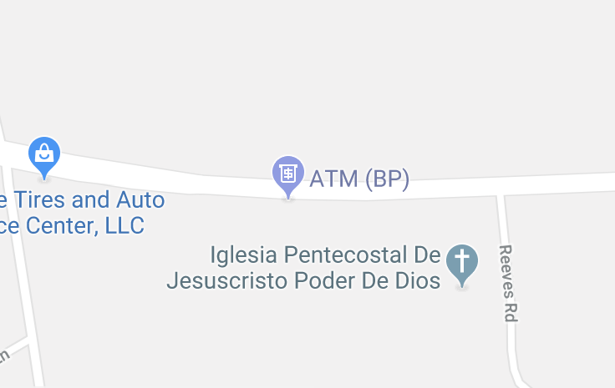
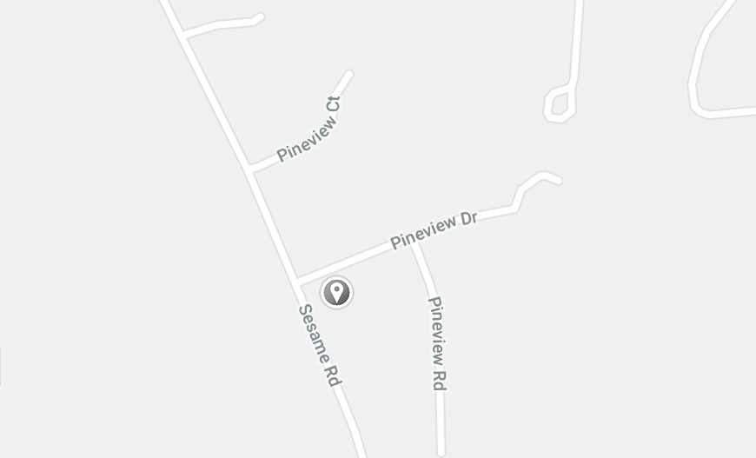
Investigating Further
First, we noted that these points are far outside city limits so its strange that the calls even go to Chapel Hill Police.
Next be using maps we figured out the more northern point is by an ATM and the southern point is in a small neighborhood.
This was further corroborated because several crimes by the ATM were theft and many in the neighborhood were domestic crimes.

Slide 11
Possible Extensions
Separating non-violent and violent crime to see if they occur in different areas
1
Filtering the crimes by month/season
2
Targeting a specific type of crime and predicting where/when it is most likely to occur
3

